Slide 1

Landscape Analysis – Initial Findings from FAIR4Health Project
Workshop session: Fostering a FAIR research culture - what works?
Kiko Núñez
Open Science Fair 2019
16-18 Sep 2019, Porto (Portugal)

Slide 2
Outline
The FAIR4Health Project
The FAIRification workflow
Guidelines for HRPOs to implement a FAIR data policy

Slide 3

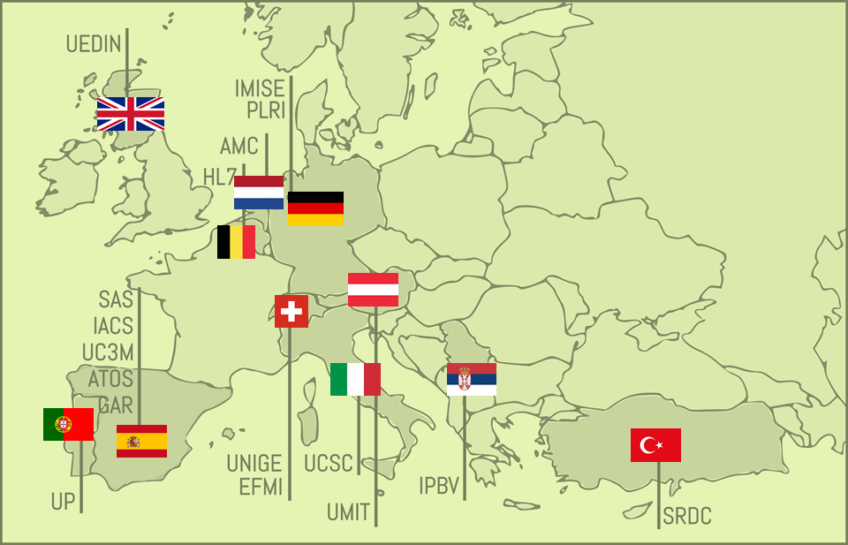
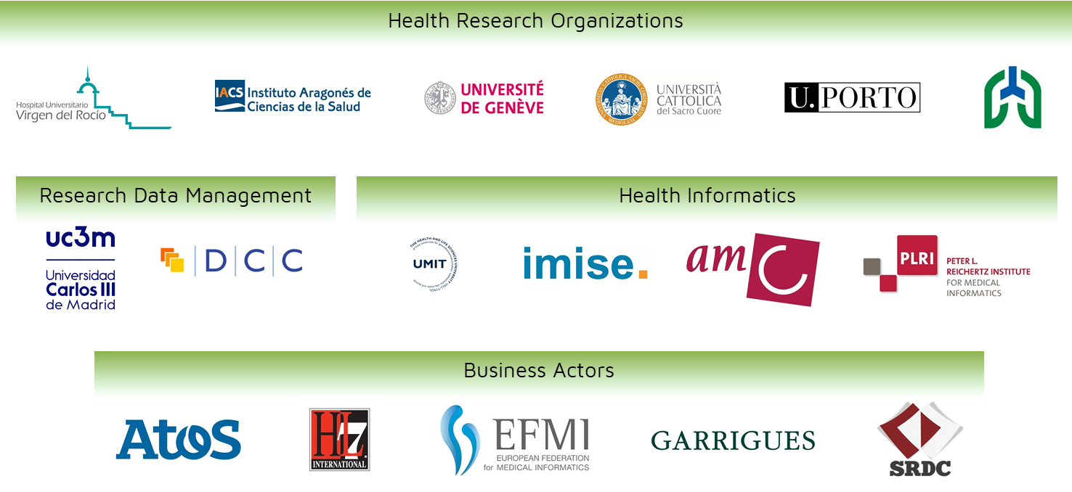

Improving Health Research in EU through FAIR data
OBJECTIVES
To facilitate and encourage the EU Health Research community to FAIRify, share and reuse their datasets derived from publicly funded research initiatives through the demonstration of the potential impact that such strategy will have on health outcomes and health research.
1. OUTREACH STRATEGY AT EU LEVEL
2. FAIR DATA CERTIFICATION ROADMAP
3. TECHNOLOGICAL PLATFORM
4. DEMONSTRATE POTENTIAL IMPACT
EC funding: 2,999,053.75 €
www.fair4health.eu
@FAIR4Health
Notes:
First of all, I’d like to thank the organisers for the opportunity to share with you our project. FAIR4Health started on last December and we are looking forward to establish collaborations and synergies at any level with all EU initiatives dealing with FAIR data in the health domain. So in case you are involved in other similar initiatives, please don’t hesitate to contact me at the end of the session and I will put you in contact with the coordinators to set out potential collaborations.

Slide 4


Demonstrators
Innovative eHealth services based on FAIR data reuse
#1 To support the discovery of disease onset triggers and disease association patterns in comorbid patients and demonstrate the reproducibility of research.
#2 To develop and pilot a prediction service for 30-days readmission risk in complex chronic patients
Notes:
FAIR4Health will design, develop and demonstrate 2 pathfinder use cases, in this case they will be innovative eHealth services based on FAIR data reuse.
The first one will address the feasibility for health researchers to work with FAIRified and federated datasets to support the discovery of disease onset triggers and disease association patterns in comorbid patients, and demonstrate the reproducibility of such research.
The second one will address the development of an innovative prediction service for 30-days readmission risk in complex chronic patients making use of a privacy preserving distributed data mining approach.

Slide 5
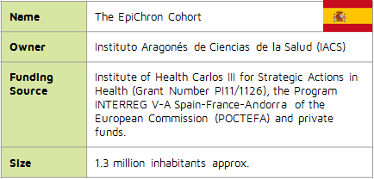
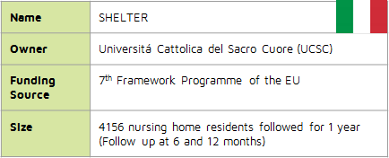
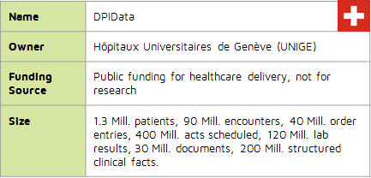
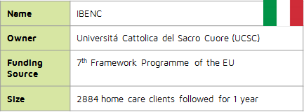
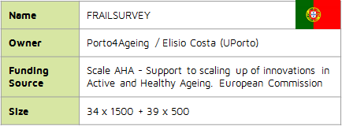
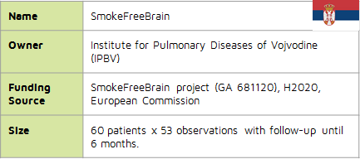

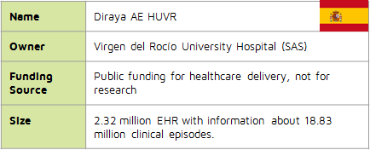
Datasets
Health and social care data from 5 million of subjects

Slide 6
FAIR4Health Vision
Open Community
eHealth Provider
eHealth Provider
eHealth Provider
eHealth Services Providers
eHealth Services Providers
Healthcare Providers
Healthcare Provider
Healthcare
Providers
Healthcare Provider
Research Institution
Research Institution
Research Institution
Health Research Institutions
Health Reseach Institutions

Slide 7








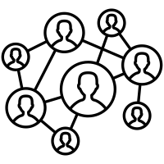
FAIRification workflow
RAW
FAIR

Slide 8

FAIRification workflow
RAW
Raw data analysis
Curation and validation
Anonymisation
License attribution
Make data linkable
Semantic modeling
Data versioning
Metadata aggregation
Archiving
FAIR

Slide 9
Guidelines: 5 principles
01
Strategic Vision
The implementation of FAIR policy implies to manage a complex change
02
Resources
There are no policies without resources and incentives supported by the needed infrastructure
03
Skills
Need to count with right knowledge and skills about FAIR data and research data management
04
Action Plan
The FAIR policy implementation must follow a clear action plan, identifying main actors and a credible timeline
05
Approval
The FAIR policy must be written down and approved by the institution
Notes:
To implement a FAIR/Open data policy implies to manage a complex change. The policy needs strategic vision and leadership.
There are not policies without resources and incentives supported by necessary Infrastructure.
It is necessary to count with the right knowledge and skills about FAIR data and research data management in the current Open Science landscape.
Before implementing any Open/FAIR data policy, the institution needs a clear action plan identifying the main actors and a credible timeline.
The policy must be written down and approved by the institution.

Slide 10
Guidelines: 10 Steps
1. Vision and Objectives
2. Responsible Team
3. Raise Awareness
4. Data Infrastructure
5. Good Practices
Describe current research, funders and their policies, research outcomes and infrastructure.
Define the objectives of the policy.
Adoption of overcoming mechanisms to enhance data sharing
Design an action plan
State resources and a feasible timeline
Provide training and assistance to researchers.
Definition of skills and a training programme
Identify and describe data storage and architecture.
Provision of tools to make data FAIR.
Research outcomes should be deposited in trustworthy repos.
Establish responsible RDM practices.
Define FAIR for implementation.
Creation of standard institutional template for DMP

Slide 11
Guidelines: 10 Steps
6. Openness
7. Standards
8. Incentivize
9. Implement
10. Assess
Determine the level of openness, transparency and re-usability of research outputs, including licensing, provenance and mechanisms for data protection
Technical decisions must be adopted regarding persistent IDs and metadata schemas for accessibility and interoperability.
Include a technical analysis of domain-specific standards
Devise credit and reward mechanisms to encourage researchers to apply the FAIR data policy
1. Write the policy
2. Submit for approval
3. Disseminate
Provide mechanisms for FAIR data assessment within the institution.
Re-align and consolidate with funders.
Notes:
Devise credit and reward mechanisms in order to ensure researchers consider it is worth allocating time and energy to data management/sharing.
Write the policy in Open/FAIR research data management
à Submit it to approval in your governance bodies
Þ Disseminate the policy inside the HRPO.
Create mechanisms for FAIR data assessment within the institution.
Re-align and consolidate the policy with the funders to guarantee that publicly-funded research data are made FAIR and Open, except for legitimate restrictions.

Slide 12



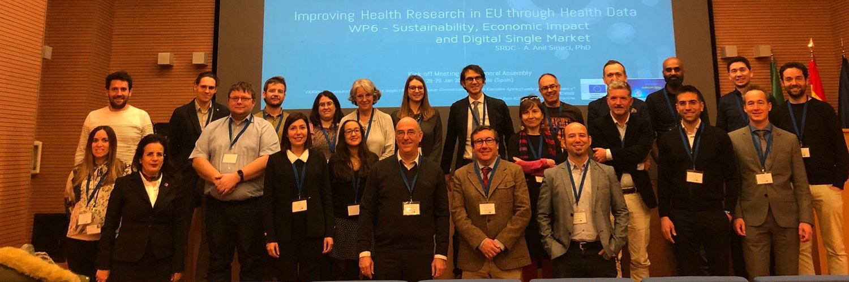
THANK YOU!
info@fair4health.eu
fair4health.eu
@fair4health

